Slide 1
Raj Laser Dental Care
Welcome to our Dental World

Slide 2
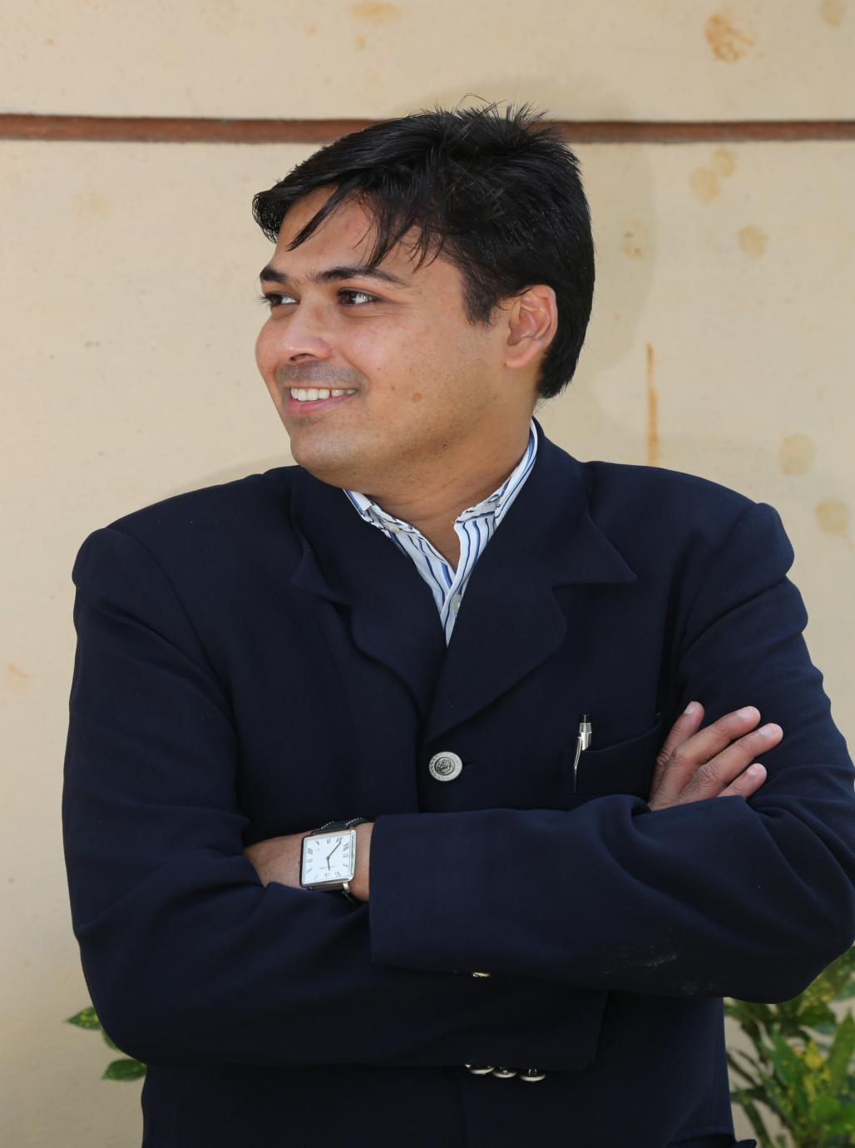
Dr Ritesh Khandelwal
Completed his graduation in Dentistry from Bharati vidhyapeeth dental college and hospital (1994-1999)
Practicing dentistry since 1999
LONAVLA CLINIC- 2001
KHOPOLI CLINIC-2006
Advanced Laser training in “AUSTRIA”
Single visit Endodontics in “USA”
Cosmetic dentistry in “FINLAND”
Basic implant course in “GERMANY” advanced implant coursein “USA”
Full mouth rehabilitation in “SWITZERLAND”
Idem “SINGAPORE”

Slide 3
Facilities
Air Conditioned clinic
Online Appointments
Two Chair Dental Seating in both Lonavala & Khopoli
Comfortable waiting area
Credit/Debit cards accpeted
Generator Backup
Computerized Digital X-Rays ( radiation free )

Slide 4
Expertise
BY UNDERSTANDING THE ART,
WE CREATE A DREAM SMILE!!
SIT BACK, RELAX AND ENJOY
Our EXPERTIZE and STATE OF THE ART equipment helps you to achieve and maintain optimum Oral Health and BEAUTY.
We take in all the ADVANCES in MODERN DENTISTRY as and when required.
Also, offer you a very different experience by putting in a lot of CARE and COMPASSION
Whether its your first time or 100th time, it “can be Scary” to visit the DENTIST. This is why RAJ LASER DENTAL CARE take extra steps to ensure your comfort. We believe Our patients deserve the best and its precisely this commitment to the “highest quality” that sets us apart.
We seek and create an “environment” conductive for all our people Working productively together to make changes needed to attain Leadership in providing HIGH QUALITY, DIFFERENTIATED PRODUCTS, And LEGENDARY PATIENT SERVICE.
You can COUNT ON OUR CARING, FRIENDLY STAFF to get to know you and recognize your INDIVIDUAL NEEDS.

Slide 5
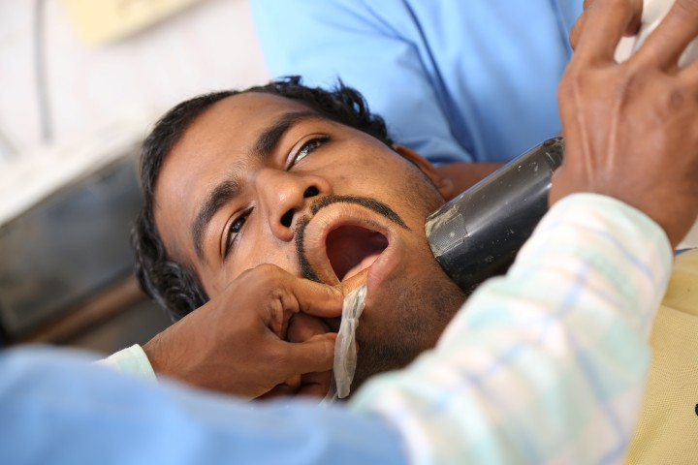
Services
GENERAL DENTISTRY
DIGITAL XRAY
COSMETIC FILLINGS
SCALING AND POLISHING
FULL MOUTH REHABILITATION
SINGLE VISIT Root canal TREATMENT
TOOTH EXTRACTION
LASER DENTISTRY
CROWNS AND BRIDGES
DENTURES
ORTHODONTICS (braces)
TEETH WHITENING
SMILE DESIGNING
PIT AND FISSURE SEALANTS
DENTAL IMPLANTS
ORAL DISORDERS AND MOUTH ULCERS
KIDS DENTISTRY
IN OFFICE FLUORIDE TREATMENT
TOOTH JEWELLARY

Slide 6
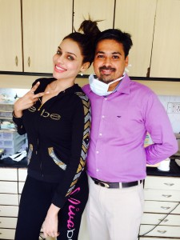
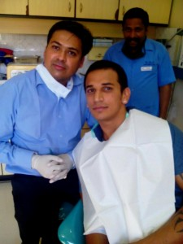
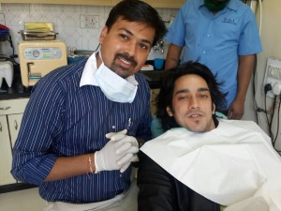
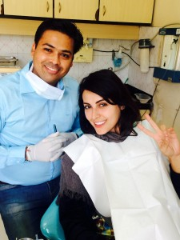
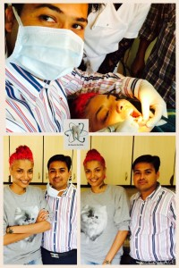
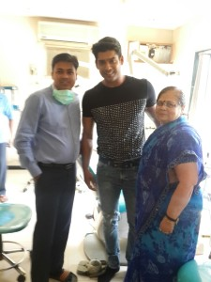
Some of the celebrities we treated

Slide 7
Our Focus
Your Comfort and Smile
With Laser Dentistry at
RAJ LASER DENTAL CARE
our number one priority is giving you a beautiful, healthy smile in comfort. We emphasize individualized customer care and are known for our gentle touch.

Slide 8
Contact Us
Lonavala:
Add: 24/2, Vardhaman Society, Lonavala
Call: 02114-278484/279494 / 8411827474
Khopoli:
Add: A-2,Anandi Park, Zenith Rd, Laxmi Nagar
Call: 02192-325853/265783
Email: riteshk@rajdental.co.in
Web: www.rajdental.co.in
FB: www.facebook.com/rajdental.co.in

